Slide 1
Feasibility of Team Training in Virtual Reality for RAMIS
20th Dec 2017
*Niclas Hjorth Stjernholm
*Oliver Gyldenberg Hjermitslev
Nicklas Haagh Christensen
Atanas Atanasov Nikolov
Frederik Falk

Slide 2

Contents
RAMIS - Introduction and Importance
Context Study
Team Training in Virtual Reality
Methods
Results
Discussion and Conclusion

Slide 3
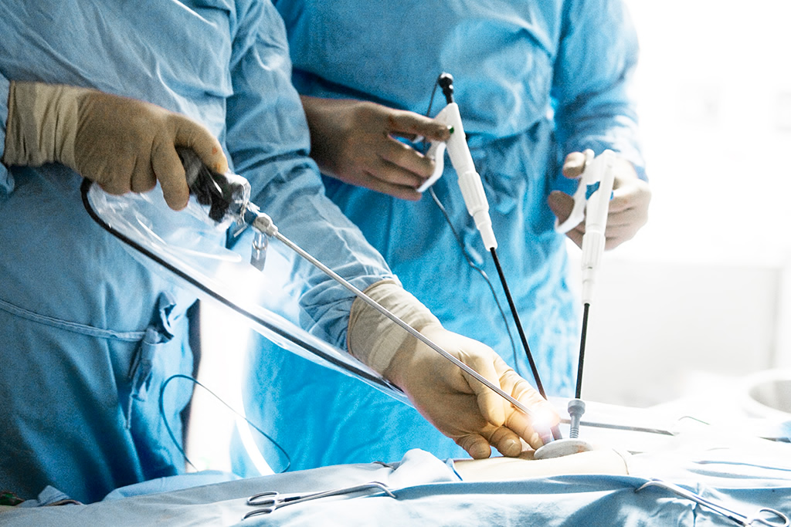
Introduction to Minimally Invasive Surgery
Small incisions
Reduced recovery time
Lower risk of injury
Requires laparoscopic tools

Slide 4
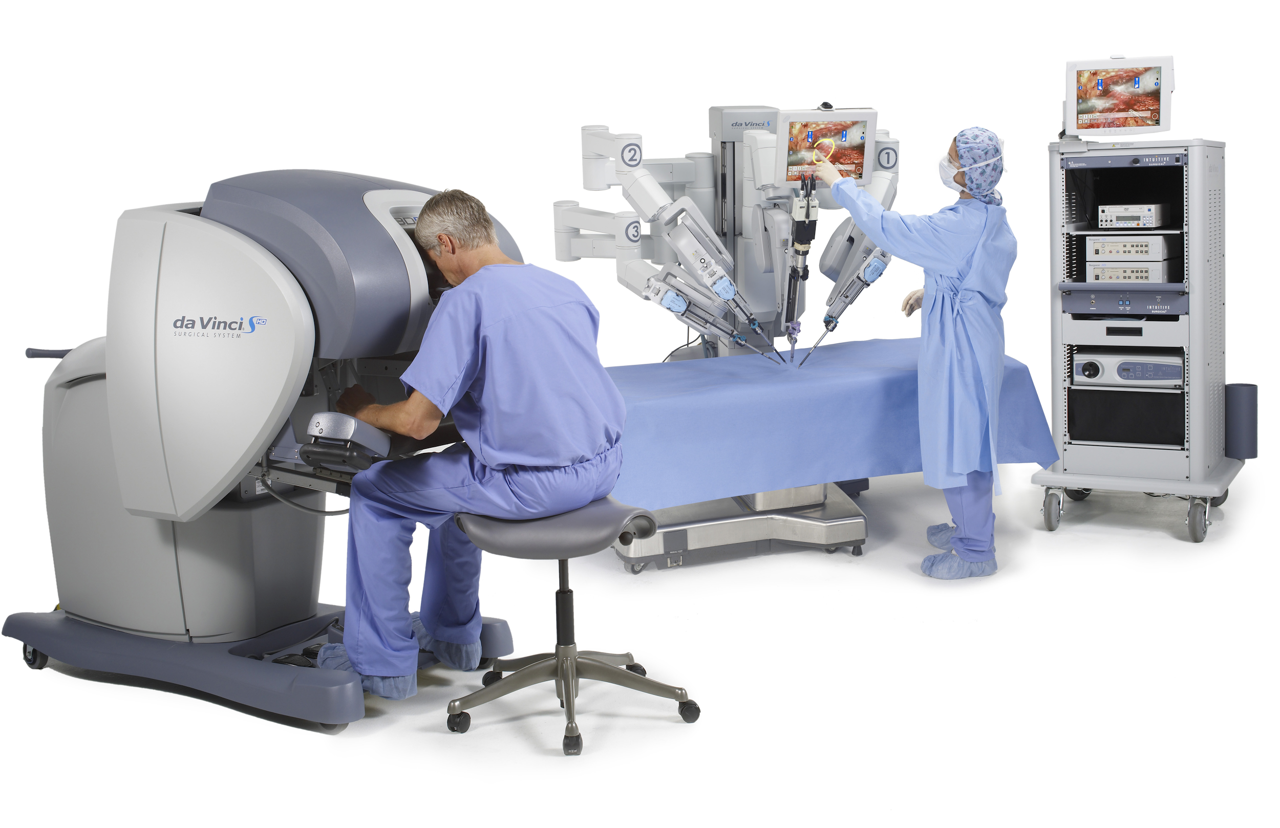
Robot Assisted Minimally Invasive Surgery
Controlled by a specialized surgeon
Surgeon operates from console
Controls multiple tools and an endoscopic camera
Nurses handle the robot and assist from outside the patient
We collaborated with MIUC on team training for RAMIS

Slide 5
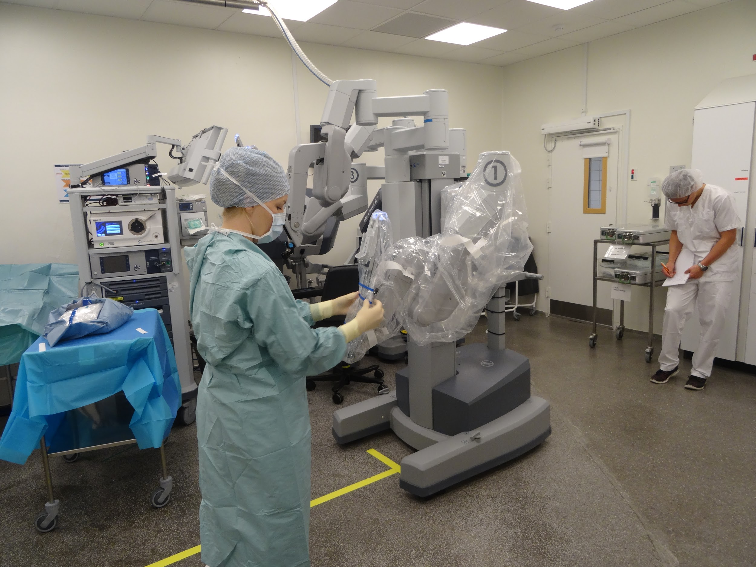
Team Training for RAMIS
RAMIS requires specialised teams to operate
Teamwork is an essential competency¹
Few centres
Expensive and time-consuming
To reduce critical events, simulation-based training has become increasingly popular²
¹E. Salas et al. http://journals.sagepub.com/doi/10.1518/001872008X375009
²R. Aggarwal, doi: 10.1136/qshc.2004.010009

Slide 6
Hypothesis:
VR can simulate Team Training with sufficient accuracy, thereby increasing accessibility

Slide 7
Context Study
5 interviews
3 training observations
1 surgery observation
Contextual Inquiry
Key training and operation procedures
Emergency Simulation
Error Handling and Troubleshooting
Standard procedures (docking, undocking)
Communication
Verbal, both trainee-trainee and trainee-instructor
May be visual using monitors or body-language, examples
Unspoken (implicit) communication
Roles
Notes:
Models will be used later :)

Slide 8
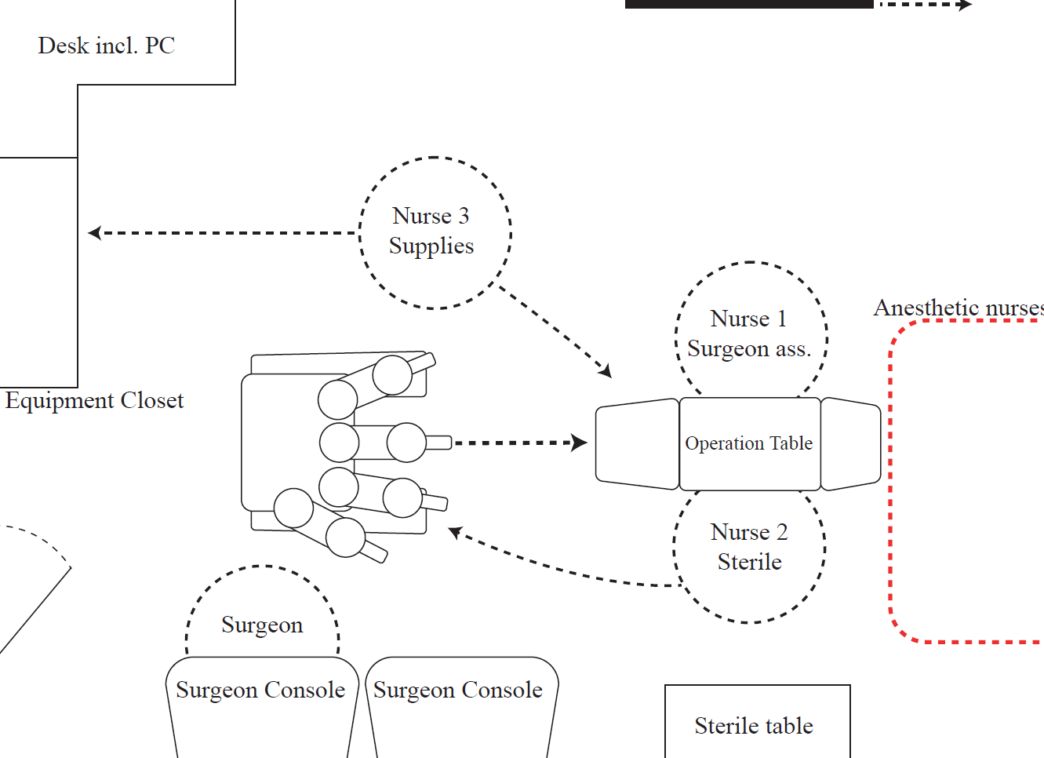
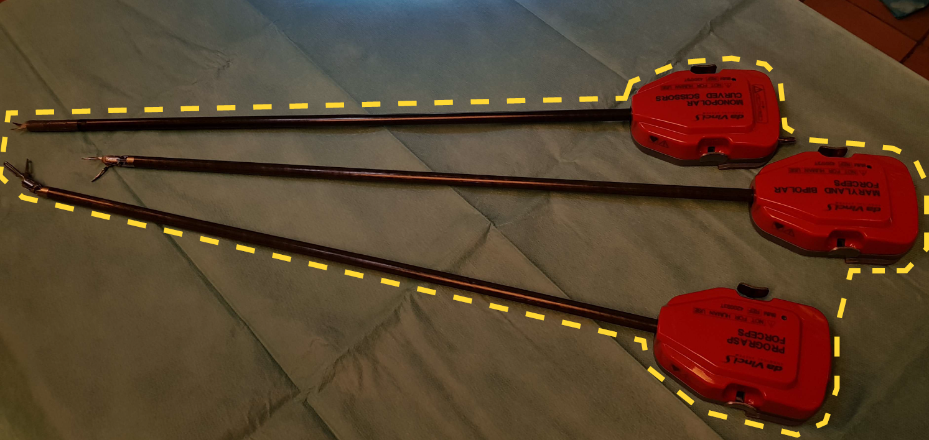
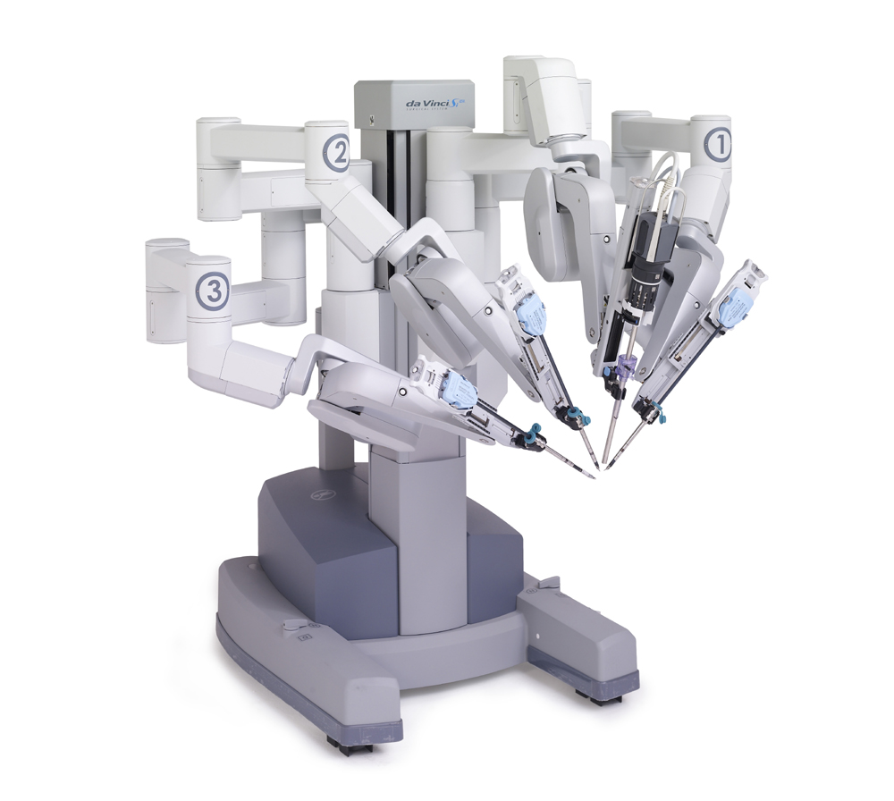
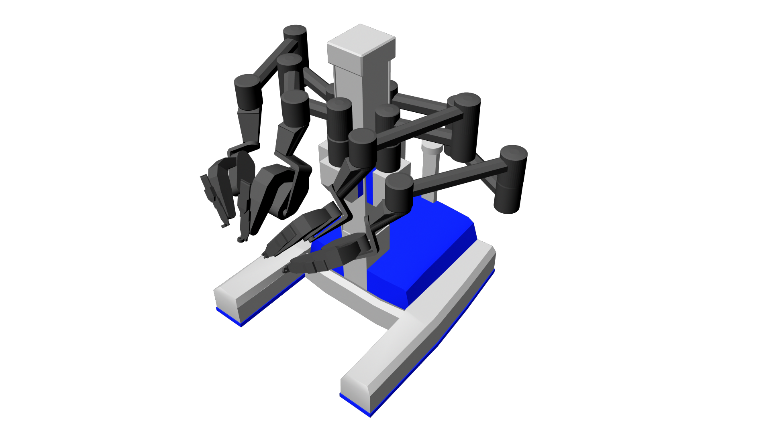
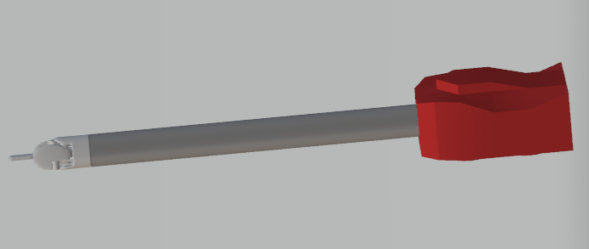
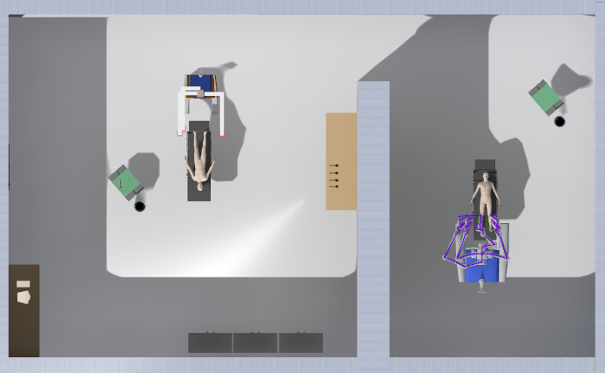
Implementing Team Training in Virtual Reality
Use the physical model to create the scene
Use the artifact model to decide which objects to implement
Use the sequence model to evaluate - which scenarios are possible?
Used Proteus in Unreal Engine 4
Communication is possible with VoIP
Notes:
We wanted to implement the team training in Virtual reality.
The psysical, artifact and sequence model are made from the contextual inquiry.
The scene is created using Unreal Engine 4. To implement multiplayer the Proteus project is used and build upon, as this is a premade multiplayer platform in VR for Unreal Engine 4.
This enabled communication using Voice over IP (VoIP).

Slide 9
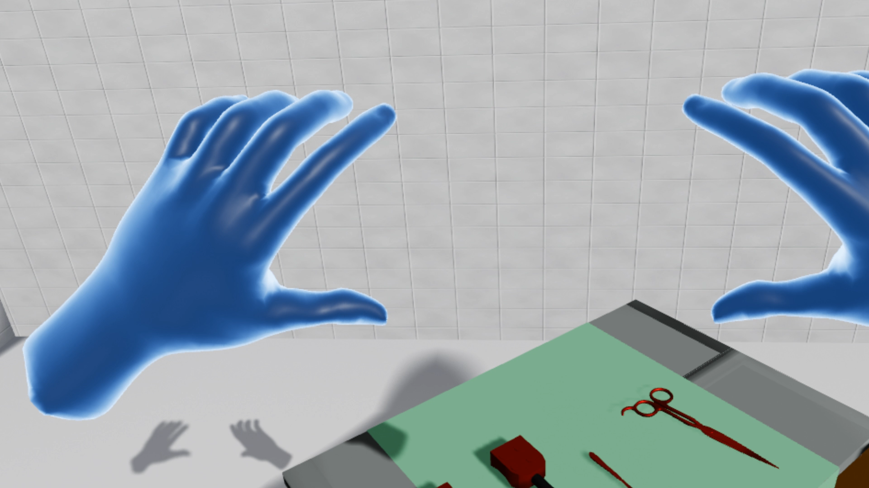
Example use in the Scene
Notes:
Here is a short video showing an example of use in the scene.
As shown in the video a shader was made to indicate grabable objects when the user’s hand is close enough to the object.

Slide 10
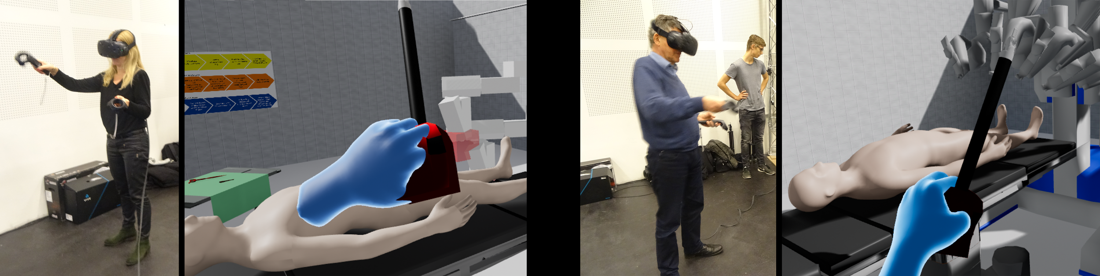
Testing Methodology
Expert Review with
Jane Petersson, first nurse assistant and nurse specialist in robot surgery
Johan Poulsen, head surgeon of robot surgery at Aalborg University Hospital
Introduced to VR with a training scene
Evaluated our scene
Introduced to VR with a training scene
Evaluated our scene afterwards
Notes:
An expert review was conducted with the two collaborative partners from MUIC.
They are firstly introduced to Virtual Reality using a training map, where they are able to ”play around”.
Afterwards they are able to evaluate the scene created and play with the movable robot and look at the design concept.

Slide 11
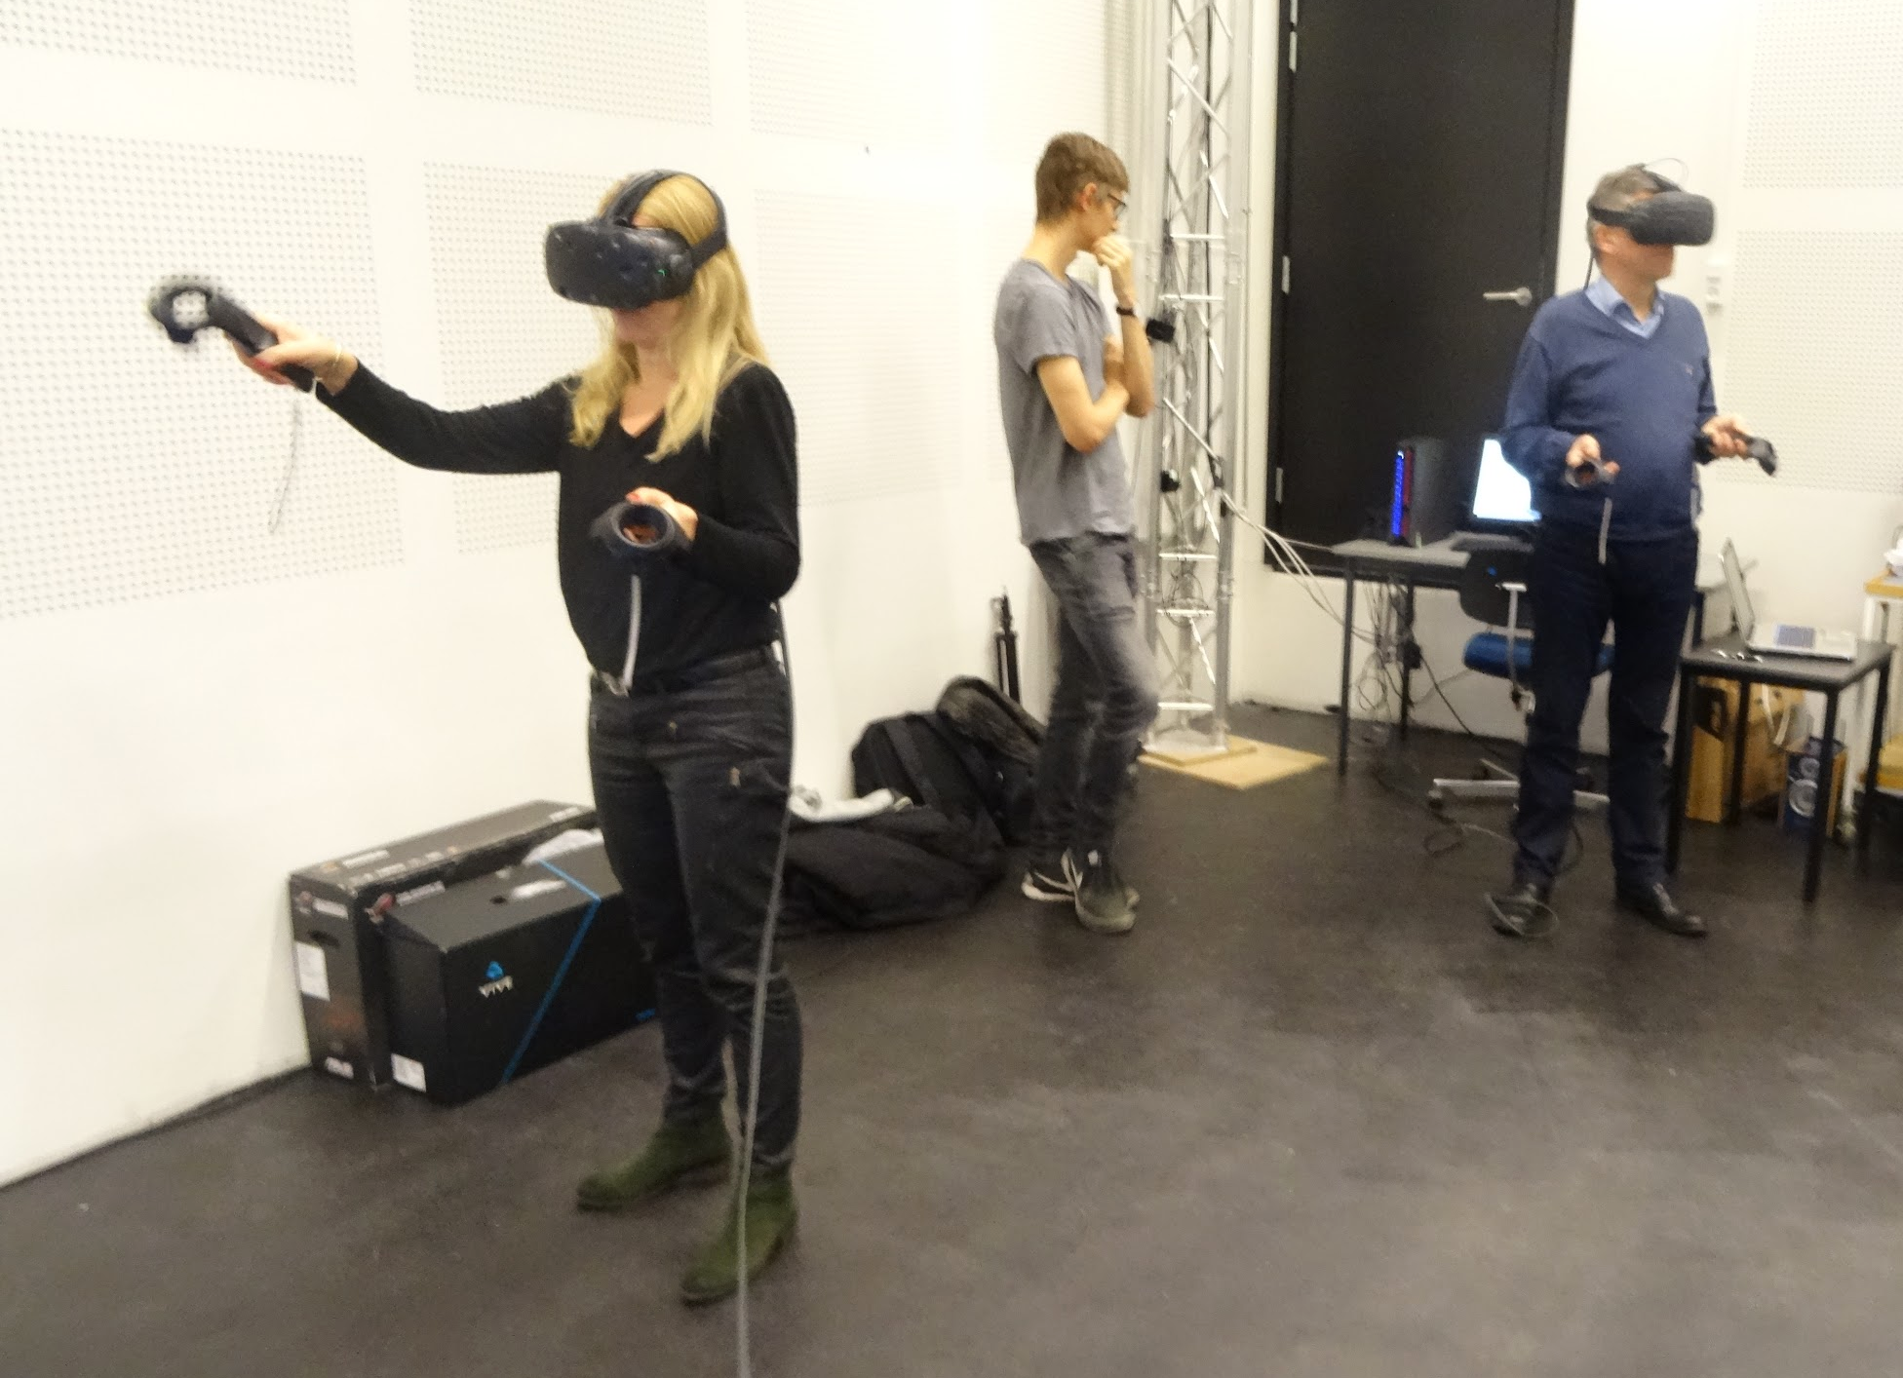
Results - Proof of Concept
The system is not complete enough to warrant implementation at this stage
VR can provide sufficient accuracy for team training
Realism is extremely important
Scenarios
Surgical staff is used to compensating for lack of tactile feedback with visuals
Experts agreed that VR training could be crucial to improving RAMIS training accessibility
Notes:
The expert review showed, that this project stands as a proof of concept.
As it stands now, the system’s realism isn’t sufficient to warrant an implementation at this stage.
Nonetheless, VR can provide sufficient accuracy for the team training.
Realism was emphasised as a very important key factor.
Different scenarios to implement was suggested. This included the one planned as emergency occurring forcing conversion to open surgery.
Scenarios could also be made with/without instructor.
As surgical staff are used to compensate visually for the lack of tactile feedback, this is not needed.
All in all, the experts agreed, that virtual reality training could be crucial to improve RAMIS training accessibility.

Slide 12
Hypothesis:
VR can simulate Team Training with sufficient accuracy, thereby increasing accessibility

Slide 13
It seems so :)
According to experts

Slide 14

Further Work
Combining simulations
Realism, trade-off with computational efficiency
Single-player to learn multiple roles
We suggest
Development of full system, including a comparison of inverse kinematic methods
Usability test of full system
Longitudinal study to determine the effects of using VR in team training for RAMIS
Notes:
It was proposed by one of the experts reviewing to combine different kind of simulations resulting in including simulations for the other staff members during RAMIS.
When implementing realism a trade-off with computational efficiency will occur at some point due to a higher polycount.
To increase role understandment and insights a single-player edition is a viable extra to implement.
We suggest:

Slide 15
Acknowledgements
Thanks to Jane Petersson and Johan Poulsen at the MIUC department on Aalborg University Hospital for participation and engagement in the project and for letting us observe training sessions as well as an operation.

